Slide 1
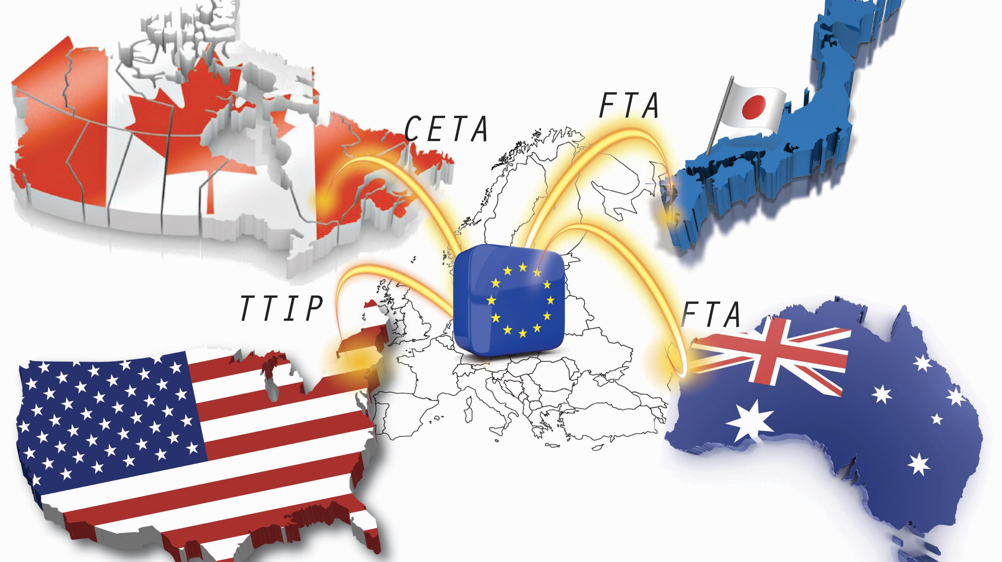
The International Seafood Trade Of United States From 1990 To 2016
A study to Showcase the power of Tableau for geospatial visualization
Created by Neena Shereen
This Photo by Unknown Author is licensed under CC BY-NC-ND

Slide 2
About the Project
Analyzing the trend of Seafood trade of US for 1990 to 2016
Data from Kaggle
Compiled information from 2 datasets: Aquaculture_Aquaculture_Exports.csv and Aquaculture_Aquaculture_Imports.csv
Aim to showcase the power of Tableau for Geospatial visualizations
Text Cleaning was done in RStudio

Slide 3
Major Data Preprocessing steps
Before
After
3540083 rows and 10 columns
Coloum for Geography code
Attribute coloum for USD value of trade
Unit coloum which measures the unit of the attribute (if the attribute is import/ export value, Unit_DESC shows US$ )
Non-Standardized name for items traded
Discarded redundant coloum
Only the USD value of the trade is considered.
Item names were reformed like: CATEGORY-TYPE-SUBCATEGORY

Slide 4
Export Items
Category | Subcategory |  | Type
TROUT | NA | SOCKEYE/RED SALMON | FRESH
SALMON | RAINBOW TROUT | COHO/SILVER SALMON | FROZEN
SHRIMPS AND PRAWNS | ATLANTIC SALMON | ROE | COOKED
OYSTERS | DANUBE SALMON | PACIFIC SALMON | CANNED
MUSSELS | CHINOOK/KING SALMON | OTHER | SALTED
CLAMS | CHUM/DOG SALMON | SHELL ON | LIVE
SCALLOPS | PINK HUMPIE SALMON | PEELED
ORNAMENTAL FISH | GENERAL | SEED OYSTERS
SHRIMPS | FRESHWATER | GEODUCK CLAMS

Slide 5
Import Items
Category | Subcategory |  | Type
TROUT | GENERAL | SHELL ON | FRESH
SALMON | RAINBOW TROUT | PEELED | FROZEN
TILAPIA | ATLANTIC SALMON | SEED OYSTERS | COOKED
SHRIMPS AND PRAWNS | DANUBE SALMON | GEODUCK CLAMS | CANNED
OYSTERS | ROE | STIMSONS CLAMS | SALTED
MUSSELS | CHINOOK /KING SALMON | RAZOR CLAMS | LIVE
CLAMS | CHUM/DOG SALMON | QUEEN SCALLOPS
SCALLOPS | PINK/HUMPIE SALMON | KOI
ORNAMENTAL FISH | SOCKEYE/RED SALMON | GOLDFISH
SHRIMP | COHO /SILVER SALMON | FILLETS
 | PACIFIC SALMON | RED TILAPIA

Slide 6
Insights from the Data
The most prominent export of US is Salmon, within which the major item is Frozen Pacific Salmon.
Majority of the export earnings were coming from China, Japan, and UK.
The main items of Import export are Shrimp and Prawns.
Frozen-peeled Shrimps are a major import item.
US have bilateral trade relations with almost all countries.
Over the years, Clams is slowly gaining importance as a highest grossing export of US; same goes to Tilapia as an item of Import trade.
The Export Import gap is more pronounced before 2004.

Slide 7
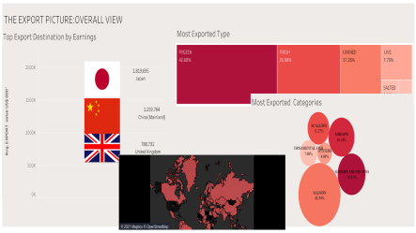
DASHBOARD

Slide 8
THANK YOU Click here to view the Tableau dashboards https://public.tableau.com/profile/neena.shereen.prathap

Slide 9


Slide 10
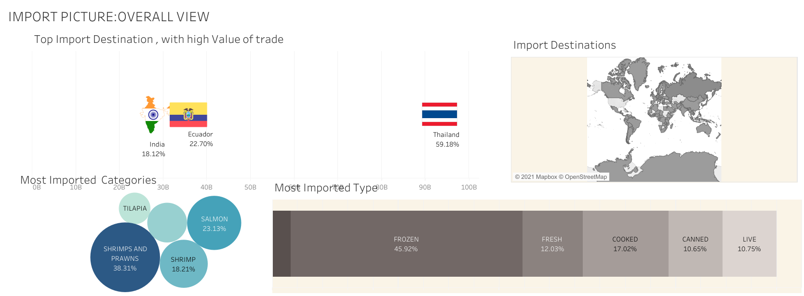

Slide 11
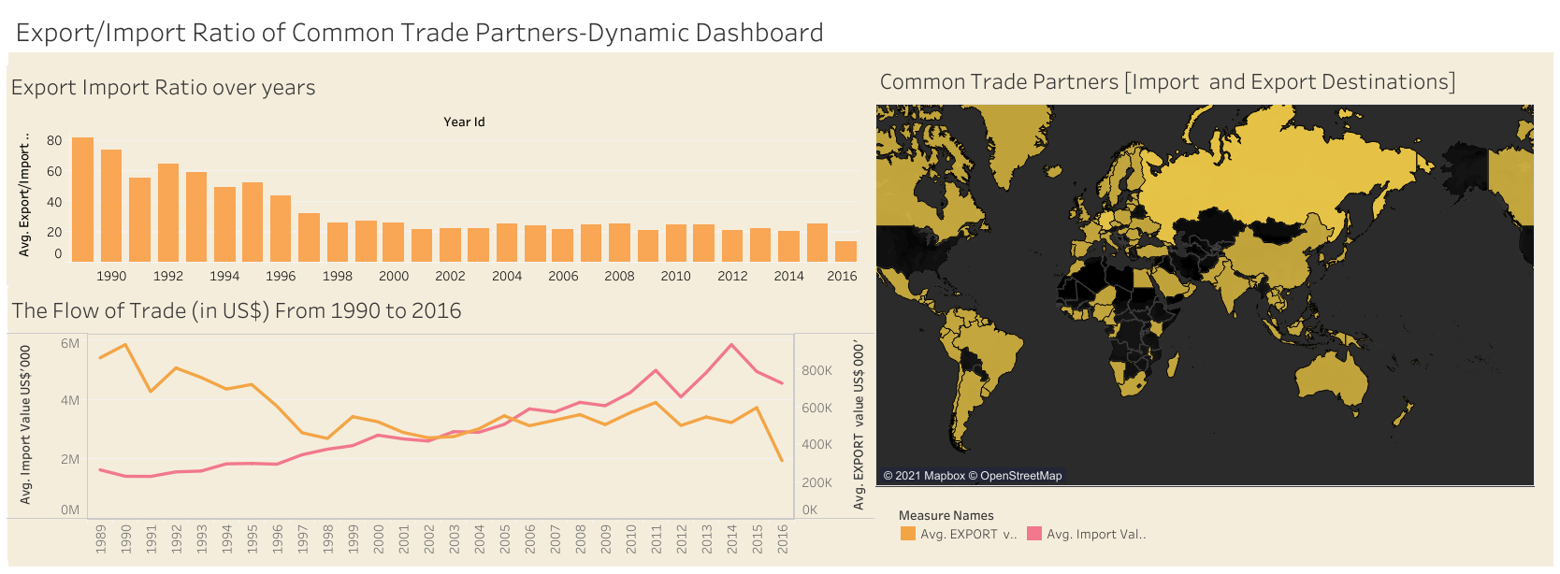

Slide 12
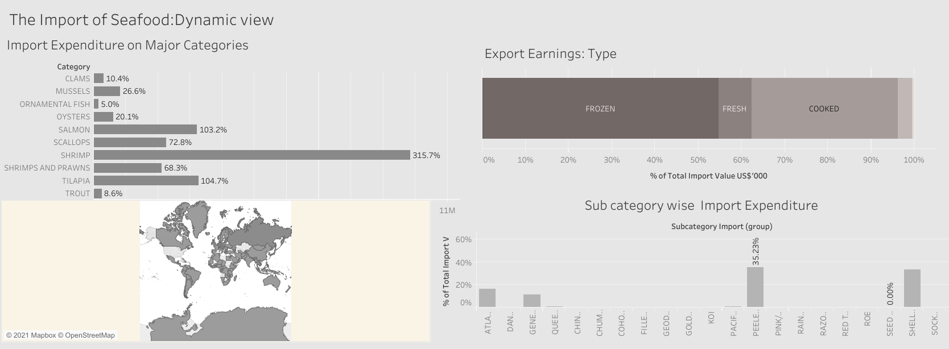

Slide 13
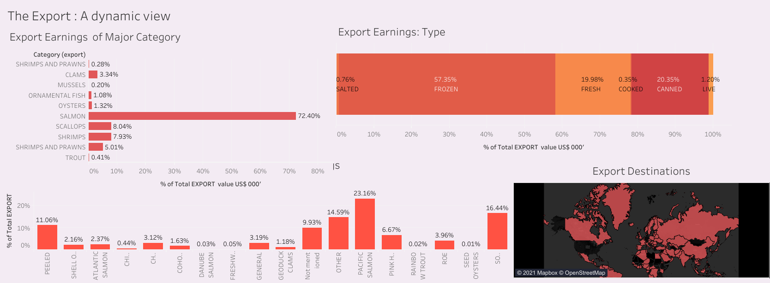

Slide 14
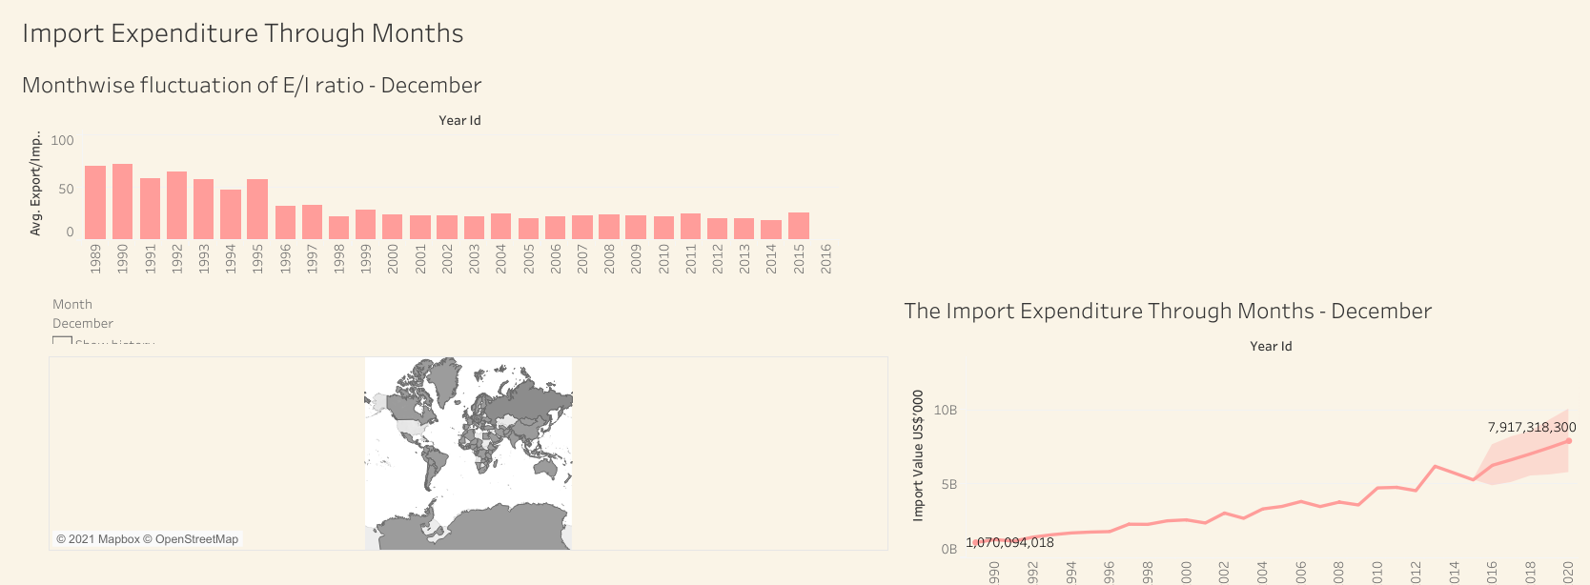

Slide 15
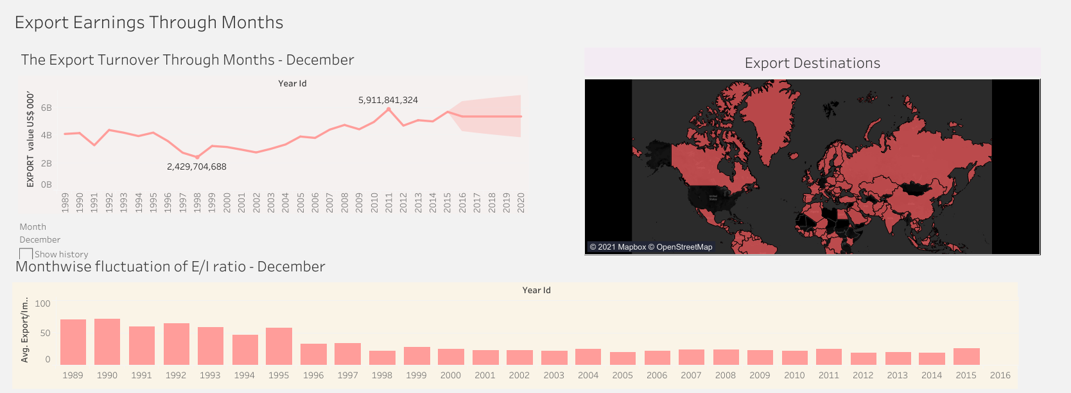

Slide 16
